Slide 1
Chapter 2: Introduction to Relational Model

Slide 2
Structure
Schema
Query language
Relational alegbra

Slide 3

Basic Unit of the Relational Model
Example of a Relation/Table:
attributes
(or columns)
tuples
(or rows)

Slide 4
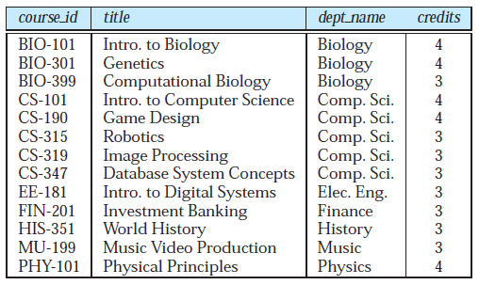
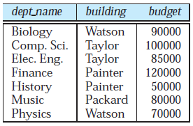
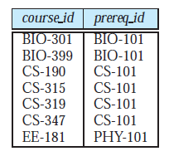
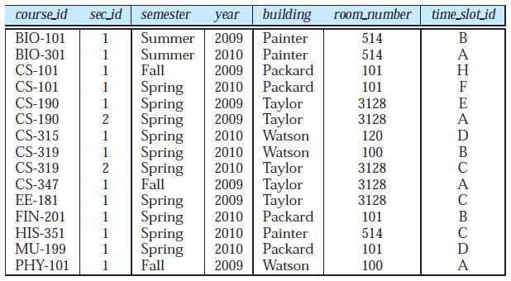
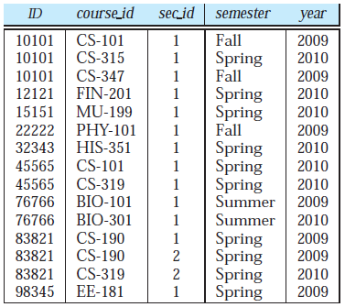

Slide 5
Table/Relation
In general, a row in a table represents a relationship among a set of values.
In the relational model the term relation is used to refer to a table, while the term tuple is used to refer to a row.
Similarly, the term attribute refers to a column of a table.
The term relation instance is used to refer to a specific instance of a relation, i.e., containing a specific set of rows.

Slide 6
Attribute Types
The set of permitted values for each attribute is called the domain of the attribute.
Attribute values are (normally) required to be atomic; that is, indivisible
The null value is a special value that signifies that the value is unknown or does not exist
Notes:
Phone no. example for Atomic

Slide 7
Relation Schema and Instance
The term relation schema is attribute set and their domains
whereas the relation instance corresponds to the values which the variable takes.
A relation schema syntax: R = (A₁ :D1, A₂ :D2, …, A_{n} :Dn )
Example:
instructor = (ID: int, name :String, dept_name : String, salary: float)
A database consists of multiple relations

Slide 8

Relations are Unordered
Order of tuples is irrelevant (tuples may be stored in an arbitrary order)
Example: instructor relation with unordered tuples

Slide 9
Database
A database consists of multiple relations
Information about an enterprise is broken up into parts
instructor
student
advisor
Bad design: Putting everything in one table
univ (instructor -ID, name, dept_name, salary, student_Id, ..)
results in
  repetition of information (e.g., two students have the same instructor)
  the need for null values (e.g., represent an student with no advisor)
Normalization theory (Chapter 7) deals with how to design “good” relational schemas

Slide 10
Keys
The values of the attribute values of a tuple must be such that they can uniquely identify the tuple.
A superkey is a set of one or more attributes that, taken collectively, allow us to identify uniquely a tuple in the relation.
K is a superkey of R if values for K are sufficient to identify a unique tuple of each possible relation r(R)
  Example: {ID} and {ID, name} are both superkeys of instructor.

Slide 12
Superkey K is a candidate key if K is minimal
Example: {ID} is a candidate key for Instructor
It is possible that several distinct sets of attributes could serve as a candidate key.
Suppose that a combination of name and dept_name is sufficient to distinguish among members of the instructor relation. Then, both {ID} and {name, dept_name} are candidate keys.

Slide 13
Candidate and Primary Key
The attributes ID and name together can distinguish instructor tuples, their combination, {ID, name} does not form a candidate key, since the attribute {ID} alone is a candidate key.
One of the candidate keys is selected to be the primary key.
The primary key should be chosen such that its attribute values are
never, or very rarely changed and it should not have null value.
It is customary to list the primary key attributes of a relation schema before the other attributes.
Primary key attributes are also underlined

Slide 14
Foreign Key
A relation, say r1, may include the primary key of another relation, say r2. This attribute is called a foreign key from r1, referencing r2.
Referencing relation – r1
Referenced relation – r2
For example, the attribute dept_name in instructor is a foreign key from instructor, referencing department.

Slide 15
DEPARTMENT
INSTRUCTOR
Referencing relation – r1- INSTRUCTOR
Referenced relation – r2- DEPARTMENT

Slide 16
Example of a Database
(with a Conceptual Data Model)
Mini-world for the example:
  Part of a UNIVERSITY environment.
Some mini-world entities:
  STUDENTs
  COURSEs
  SECTIONs (of COURSEs)
  (academic) DEPARTMENTs
  INSTRUCTORs
Slide 1- <number>

Slide 17
Example of a Database
(with a Conceptual Data Model)
Some mini-world relationships:
  SECTIONs are of specific COURSEs
  STUDENTs take SECTIONs
  COURSEs have prerequisite COURSEs
  INSTRUCTORs teach SECTIONs
  COURSEs are offered by DEPARTMENTs
  STUDENTs major in DEPARTMENTs
Note: The above entities and relationships are typically expressed in a conceptual data model, such as the ENTITY-RELATIONSHIP data model (see Chapters 3, 4)
Slide 1- <number>

Slide 18

Example of a simple database
Slide 1- <number>

Slide 19

Schema Diagram for University Database

Slide 20
Schema
classroom(building, room_number, capacity)
department(dept_name, building, budget)
course(course_id, title, dept_name, credits)
instructor(ID, name, dept_name, salary)
section(course_id, sec_id, semester, year, building, room_number, time_slot_id)
teaches(ID, course_id, sec_id, semester, year)

Slide 21
student(SID, name, dept_name, tot_cred)
takes(SID, course_id, sec_id, semester, year, grade)
advisor(sID, iID)
Time_slot(time_slot_id, day, start_time, end_time)
prereq(course_id, prereq_id)

Slide 22
TEACHES

Slide 23
Relational Query Languages
A query language is a language in which a user requests information from the database.
Categorized as procedural or non procedural
Procedural: The user instructs the system to perform a sequence of operations on the database to compute the desired result.
Nonprocedural: user describes the desired information without giving a specific procedure for obtaining that information.
Notes:
Non- procedural, or declarative: the user describes the desired information without giving a specific procedure for obtaining that information.

Slide 24
In a procedural query language, like Relational Algebra, you write a query as an expression consisting of relations and Algebra Operators, like join, cross product, projection, restriction, etc.
On the contrary, query SQL are called “non procedural” since they express the expected result only through its properties, and not the order of the operators to be performed to produce it

Slide 25
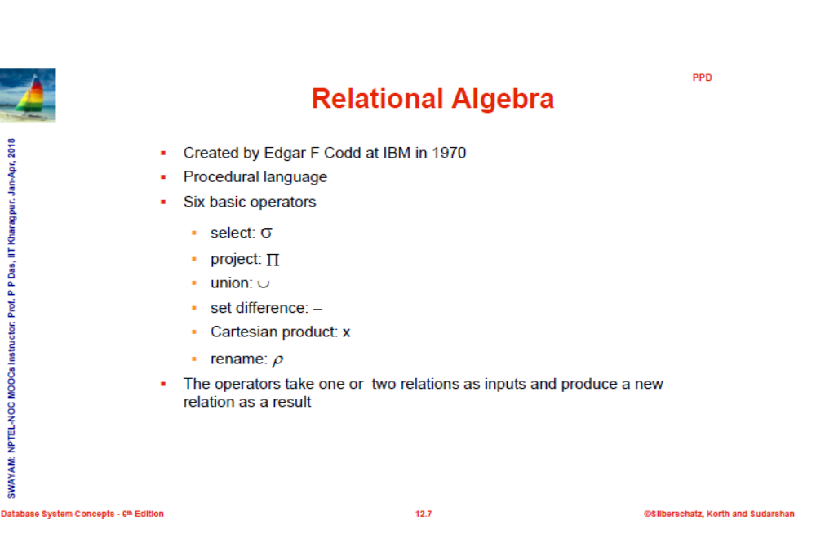

Slide 26
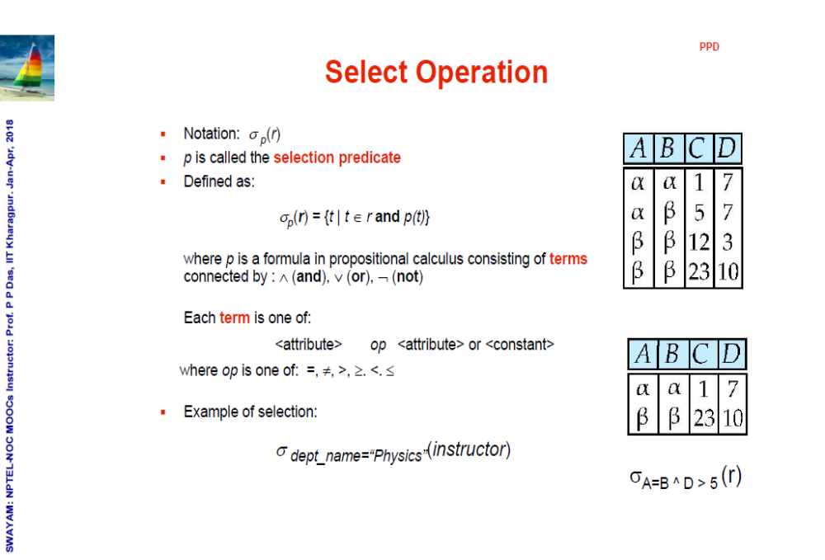

Slide 27
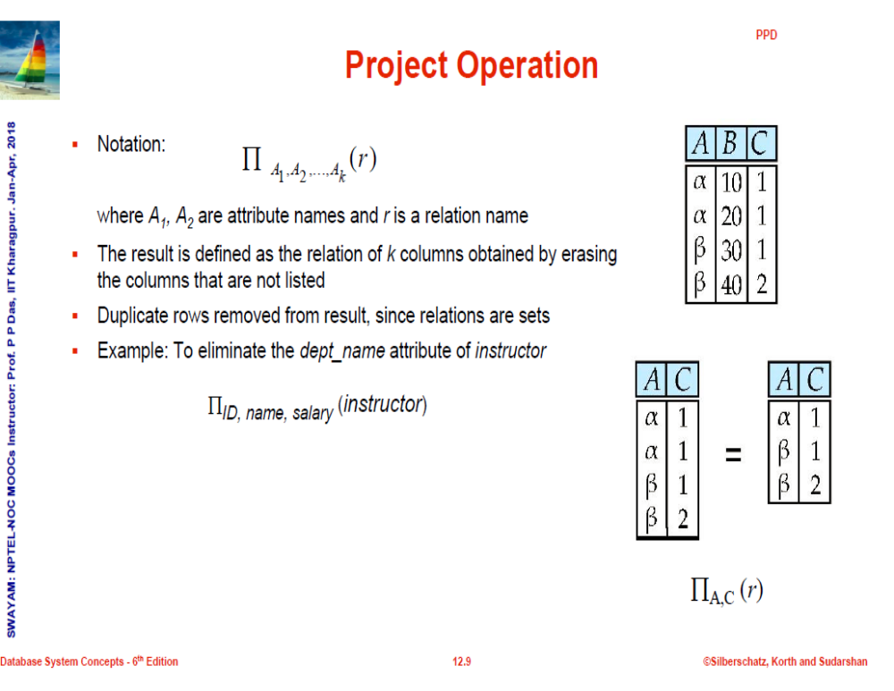

Slide 28
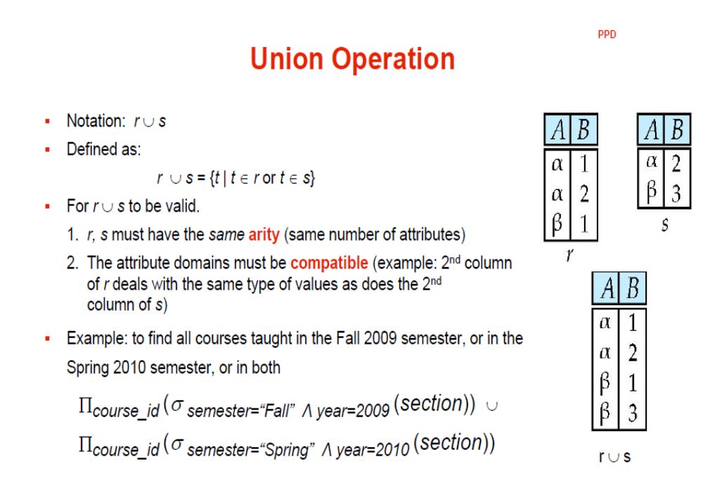

Slide 29
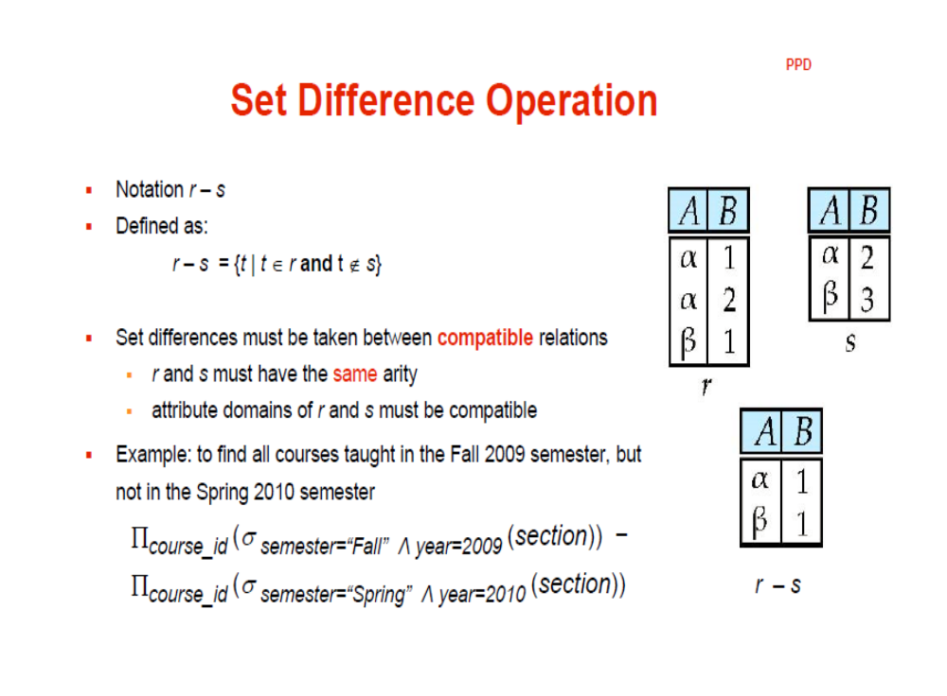

Slide 30
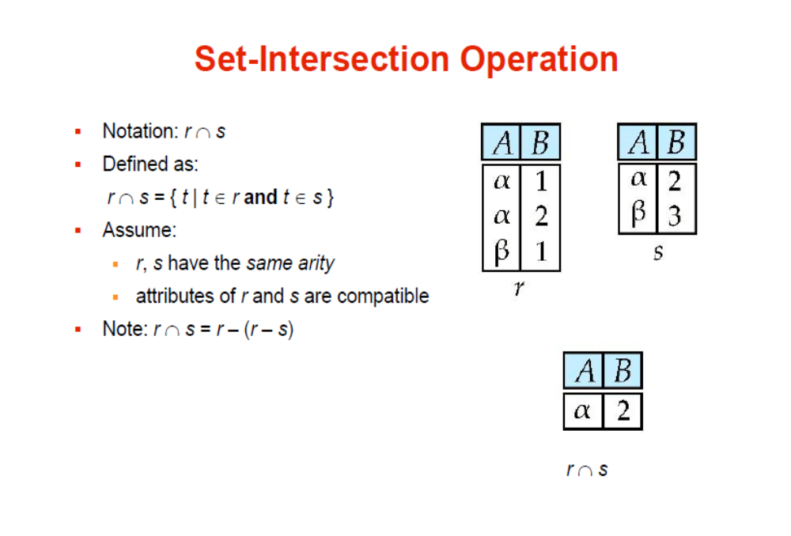

Slide 31
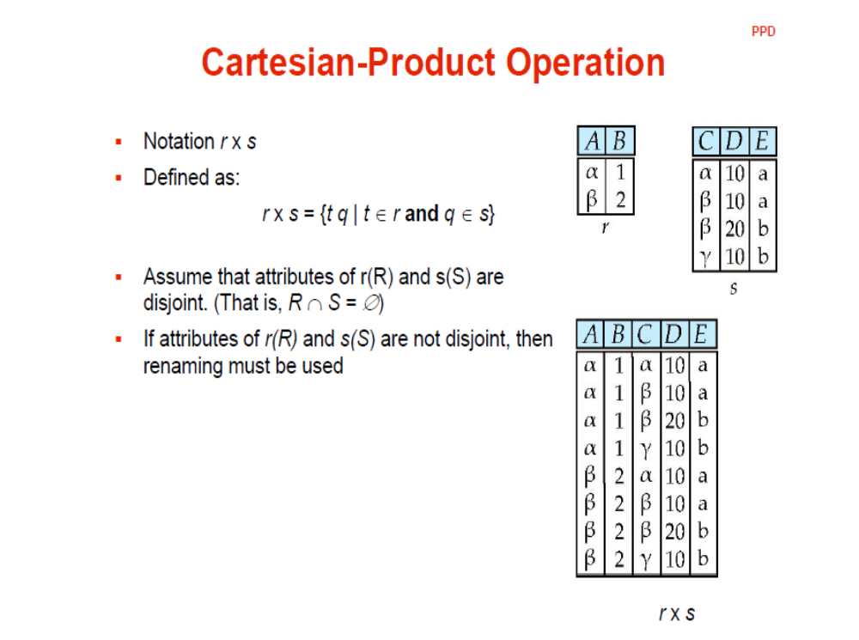

Slide 32
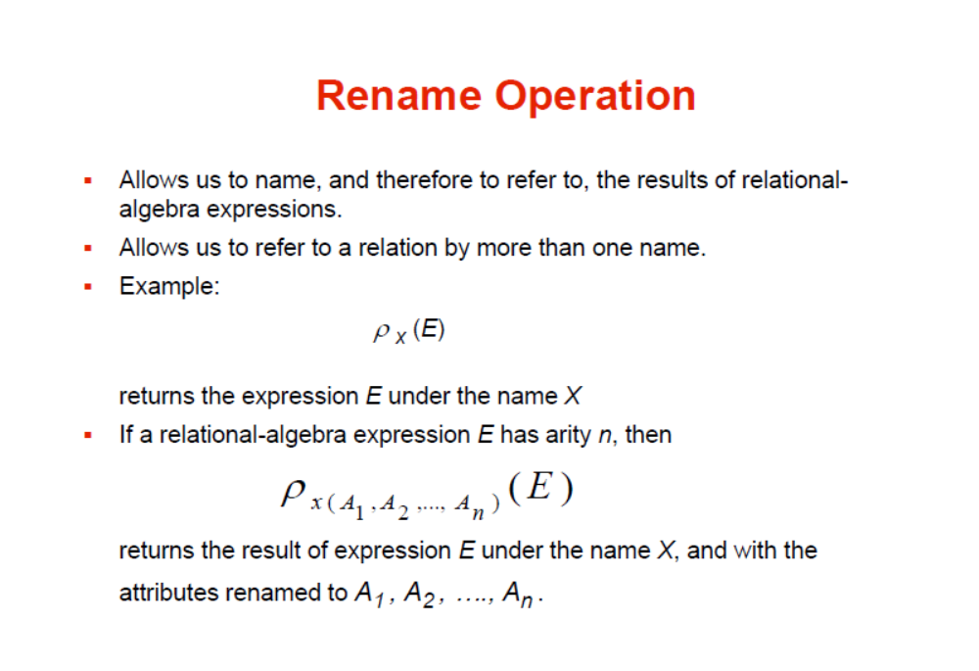

Slide 33

Natural Join- Example
The natural join operation on two relations matches tuples whose values are the same on all attribute names that are common to both relations.
Relations r, s:
Natural Join
  r s

Slide 34

JOIN operation
Joins two relation instructor and department on a COMMON attribute

Slide 35
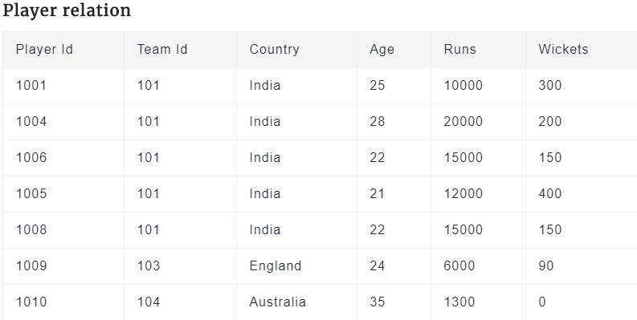
Exercise for students

Slide 36
Select all the tuples for which runs are greater than or equal to 15000.
Select all the players whose runs are greater than or equal to
6000 and age is less than 25
3. List all the countries in Player relation.

Slide 37
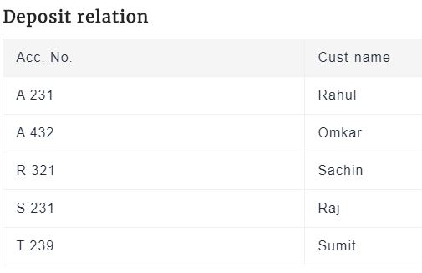
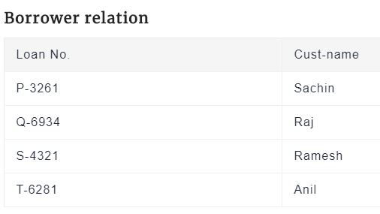

Slide 38
1. Find all the customers having an account but not the loan.
2. Find all the customers having a loan but not the account.
3. Rename Player relation to PlayerList.

Slide 39

Union of two relations
Relations r, s:
r ∪ s:

Slide 40

Set difference of two relations
Relations r, s:
r – s:

Slide 41

Set Intersection of two relations
Relation r, s:
r ∩ s

Slide 42

Figure 2.06

Slide 43

Figure in-2.1

Slide 44
End of Chapter 2

Slide 45
Figure 2.01

Slide 46

Figure 2.02

Slide 47

Figure 2.03

Slide 48
Figure 2.04

Slide 49

Figure 2.05

Slide 50

Figure 2.07

Slide 51

Figure 2.10

Slide 52
Figure 2.11

Slide 53
Figure 2.12

Slide 54

Figure 2.13

